Slide 1

Post Quantum Cryptography
SQUIRRELS - Project II
Names: Al Fahim, Jaraad Hussain, Leonardo Yeung, Daymon Wu

Slide 2

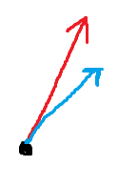
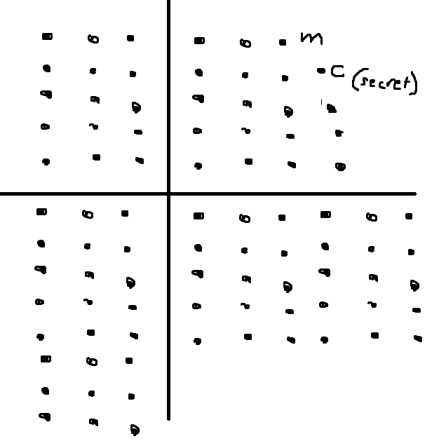
GGH to GPV
Visualization
Secret basis/private key
Public basis/public key
GGH
Maps a message m to a random point in Euclidean Space, denoted c
A secret basis, composed of short and nearly orthogonal vectors, is used to sample a lattice point that is close to c
The verification process checks if the signature is a lattice point close to c using a public basis
Leaks too much information about the shape of the secret basis
GPV
Randomizes the selection of the lattice point, enhancing the security
Produces signatures that are statistically close to a discrete Gaussian distribution centered on the message, concealing the secret basis shape

Slide 3
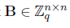
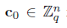
GPV Framework
Key Compounds
Public Key: A full-rank matrix
Secret Key: A matrix with short entries such that 0
Hash Function and Signature
Given a message m′, we first hash it to H(m′)
To sign the message, you first create a scrambled version of the hash message using a preimage
Valid signature is
H = Hash function
s = Short vector

Slide 4
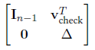
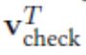
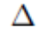
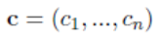
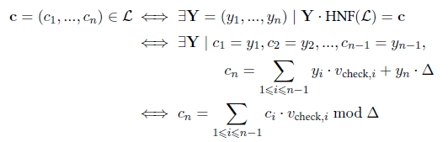
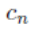
Co-cyclic lattices
HNF
What is a Co-cyclic Lattice?
A grid extending infinitely, composed of points with integer coordinates known as an integer lattice, L
Co-cyclic lattices are formed when the quotient group is cyclic, meaning all points can be generated from a single point by addition or subtraction
They are prevalent in lattice structures (about 85% density), offering useful properties for cryptography
Cryptographic Significance:
Hardness Problems: The security of cryptographic methods using lattices relies on difficult problems like SVP (Shortest Vector Problem) and CVP (Closest Vector Problem), which remain challenging in co-cyclic lattices
Hermite Normal Form (HNF):
A standardized representation of a lattice that simplifies the verification of whether a point is part of the lattice
Utilized in checking signature validity efficiently
Application in Signature Schemes:
Co-cyclic lattices allow for the development of reliable trapdoors, crucial for the creation and verification of secure digital signatures within schemes like the GPV framework
Lattice Verification Check
= identity matrix of size n-1
= transpose of the vector Vcheck, part of public key
0 = Row of zeros, indicates that there are no cross terms
= determinant of the lattice (L), volume spanned by the lattice
= This is a vector that we want to test for membership in the lattice
= Lattice, which is a set of points in space
= vector when multiplied by the HNF of
= nth component of the vector c
= individual components of the vector Y
= individual components of the vector

Slide 5

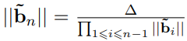
Key Generation Computations
The first step in the process generates n - 1 vectors. These vectors are part of the basis for the lattice.
The Gram-Schmidt process is applied to these vectors to make them orthogonal (perpendicular to each other in the geometric sense). The norms of these orthogonal vectors are controlled by the values, gmin & gmax
The norm of the last Gram-Schmidt vector is specifically bounded to ensure that the determinant of the lattice is maintained.
This is done by controlling the value of delta, which is the sum of the logarithms of the norms of the Gram-Schmidt orthogonalized vectors divided by a scaling factor related to the determinant and the vector's index.
Formula used to bound the norm of the vector
Multiply the norms of all the vectors from 1 to i - 1

Slide 6
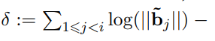
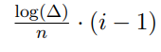
Computation of the last secret vector
Once the first n - 1 vectors are generated, the last vector, vlast, is computed. Completes the basis and ensure that determinant is as desired
When computing for vlast, minors from the matrix are used and they must be co-prime
A minor of a matrix is the determinant of a smaller square matrix within the original matrix
Co-prime matrix minors means the integers in the matrix have no common divisors other than 1
For efficiency, only the last four matrix minors are computed since they have a high chance of being co-prime
Vlast is controlled by a variable, “i”, to ensure that it is small for security purposes
Formula used to control the value of the last vector
Sum of logs of the orthogonal norms - the determinant values

Slide 7
Reducing last vector for efficiency
We want the last vector to have small coefficients for efficiency, so we reduce in three steps:
The coefficients are reduced using the ComputeReducedGCD algorithm to ensure their absolute values are lower than a certain threshold. This is important to keep the lattice basis as small and efficient as possible.
A further reduction is done by constructing a matrix with these coefficients and performing an LLL reduction, a process that helps to find a shorter and nearly orthogonal lattice basis.
Finally, the Babai Nearest Plane algorithm is applied to the coefficients to further reduce the vector, vlast (uses projection to find close lattice point to target determinant)

Slide 8

Public Key Derivation and Efficiency
From the complete secret lattice basis B, the row Hermite Normal Form (HNF) is computed to ensure a co-cyclic lattice structure, leading to the extraction of the public key.
Efficient algorithms like Pernet-Stein are employed to compute the HNF, optimizing the key generation process.
Pernet-Stein is faster than older methods because it uses modular arithmetic and other optimizations that can handle large matrices more effectively.
Library called Flint structure is used to handle the heavy computational task when working with large integers and performing matrix operations like computing the determinant and Hermite Normal Form (HNF)

Slide 9

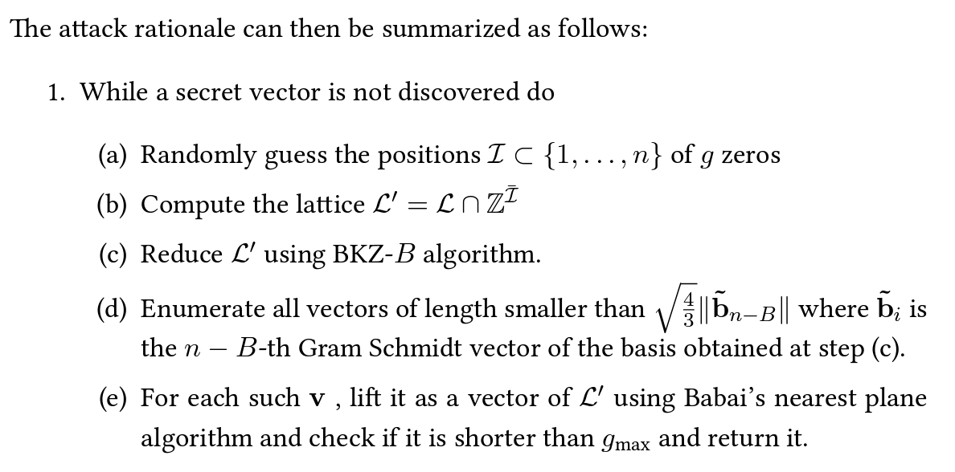
Hybridizing an Attack for Sparse Secrets ( Recall)
Last time I talked about…

Slide 10
Evaluating the Sparsity Level of Secret Vectors:
Evaluating the sparsity level of secret vectors involves understanding how many elements in a vector are non-zero. If a secret vector is sparse it means most of the elements are zero. If the elements are not sparse the elements are non-zero
Reasons why you would want to know how many elements in the vector are nonzero:
Checking Security: We need to know if there’s a specific pattern to which numbers are important and which can be zero
Making things faster: If lots of numbers in the list are zero, we can do clever tricks to make calculations faster
Avoiding Mistakes: If we understand which numbers matter, we can better fix these mistakes that might happen when using secret codes
Choosing the right settings: The choice of parameters like key lengths and security levels are important; a more sparse vector might need adjustments to maintain a desired level of security.

Slide 11
Understanding Sparsity in Secret Vectors
To figure out how many zeros are in our secret vector.
Here is how we do it:
Use the Gaussian Model: We imagine the zeros in our list like points on a graph, to see how they’re spread around.
-The Gaussian Model is centered at zero so the probabilities of values decrease symmetrically as you move from zero
-The spread or width of the distribution is controlled by the standard deviation (σ) sigma
-gmin/√n means in a continuous setting the average size of vectors is gmin.
Gmin represents the minimum desired norm for the vectors
Continuous setting means the mathematical formula is designed to work smoothly with any real numbers with no gaps in between.

Slide 12
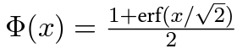
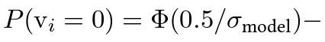
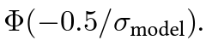
Understanding Sparsity in Secret Vectors
Probability of Zeros:
We calculate the chance that each number on the list is zero with the cumulative distribution formula. To calculate the probability of each individual vector we use this formula.
Counting Zeros in a Vector:
For one of our secret vectors, we count how many zeros we expect based on the probability.

Slide 13
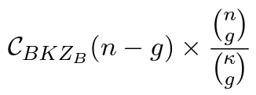
Understanding Sparsity in Secret Vectors
There is always a plan to attack these vectors, and we want to understand how hard it is for someone to do it. The main goal is to figure out how resistant our system is to potential attacks.
This kind of formula is often used in cryptography to represent a measure of complexity..
We want to pick the best settings for our system. This means finding the right parameters (like how spread out the zeros are) to make sure our system stays secure and works well.

Slide 14
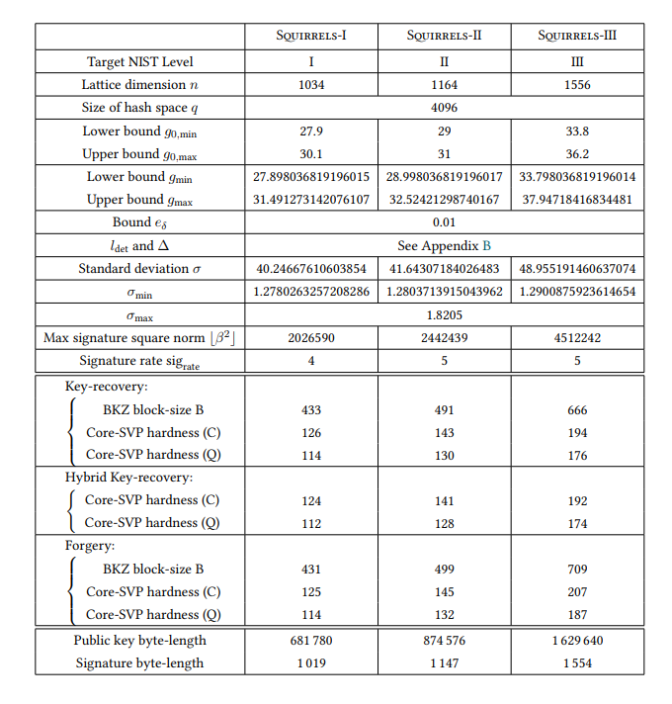
Recommended Parameters
Bounds on sampled norms (g0_min and g0_max): These are the minimum and maximum norms for lattice vectors that are acceptable in the scheme. Tight bounds are preferred to ensure security (high g0_min) and performance (low g0_max).
Standard deviation σ of the signatures: This parameter affects the distribution of the signature sizes. The distribution is Gaussian and is derived from Klein's sampler, which is an algorithm used for sampling lattice points. The choice of σ is critical for the scheme's security.
Maximal norm β of the signatures: This is the maximum norm allowed for a valid signature. Signatures that exceed this norm are considered too large and are rejected to avoid security risks.
Signature byte-length size_sig and sig_rate: These parameters are related to the size of the signatures. The sig_rate is a factor that influences the average size of the signatures, and size_sig is the average size itself. The goal is to minimize size_sig while maintaining security.
Notice the values are small and close to each other
Chooses the smallest sig_size
Larger block sizes and higher hardness parameters indicate better resistance to attacks.
Byte length significantly increases as the security level increases

Slide 15

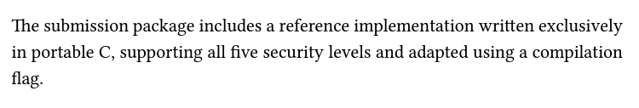
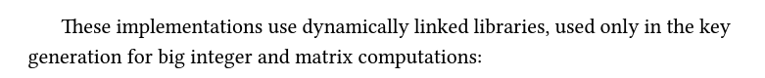
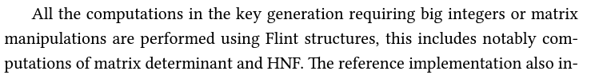
Description of the Reference implementation
What is the need for dynamically linked libraries rather than doing it yourself?
Libraries are already established and widely used for their efficiency and reliability.
Reduce the need to implement complex algorithms from scratch.
Maintenance is simplified since updates and improvements to these libraries can be adopted without modifying the main algorithm implementation.
Highly optimized for performance and take advantage of low-level optimizations.
Using optimized libraries can significantly enhance the performance of these operations.
Makes the implementation more portable across different platforms.
Libraries like GMP and Flint are designed to efficiently manage resources, such as memory, during large-scale computations.
Libraries helps in effective resource utilization, preventing memory leaks and optimizing the overall efficiency of the key generation process.
*Portable C refers to being able to use code on any system without modifying code*
software library for arbitrary-precision arithmetic, also known as bignum arithmetic. It provides a set of functions for performing arithmetic operations on integers, rational numbers, and floating-point numbers with very large or very high precision.
GMP (GNU Multiple Precision Arithmetic Library)
Flint
fplll "Fast Polyhedral Lattice Linear algebra Library."
Flint is designed to offer efficient and reliable operations on integers, rationals, polynomials, matrices, and more. It is specifically tailored for mathematical research and computational number theory
library for lattice algorithms. It is designed to provide efficient and flexible implementations of algorithms related to lattice problems, which have applications in various areas, including cryptography and computational number theory.

Slide 16
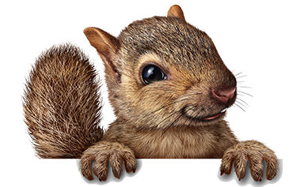
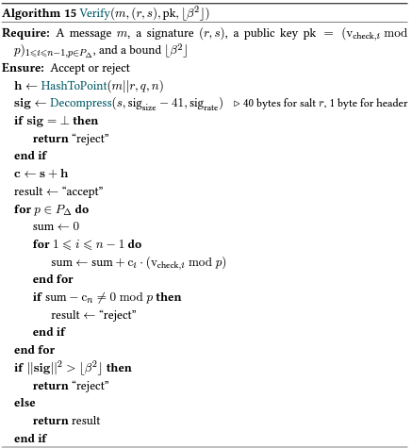
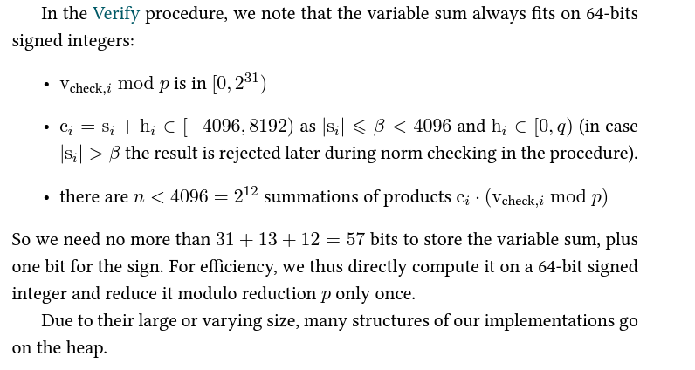
From Last time:
The algorithm computes variables, specifically, directly on a 64-bit signed integer. This is done to streamline the computation process, and potentially saving processing time and resources.
Reducing the result modulo to be done only once. This is for a computational optimization.
Modulo operations can be computationally expensive, so reducing them to a minimum can improve the overall efficiency of the algorithm.
In binary, 2^31 requires 32 bits to represent, but since the range is [0, 2^31), the highest value needed is 2^31 - 1, which indeed can be represented in 31 bits.
If we consider the upper limit, 4095, in binary, it requires 12 bits (2^12 = 4096), but we need one additional bit for the sign, making it a total of 13 bits
When you sum these three components (31 + 13 + 12), you get 56 bits.The extra 1 bit is to sign.

Slide 17

THANK YOU

